Slide 1




Node.js Web Server
Simple Web Server, Tools
Node.js Web Server
SoftUni Team
Technical Trainers
Software University
http://softuni.bg

Slide 2

Table of Contents
The Web Server
Parsing URL’s
The Request/Response Objects
Routing Requests
Additional Tools

Slide 3
Have a Question?
sli.do #express-js

Slide 4
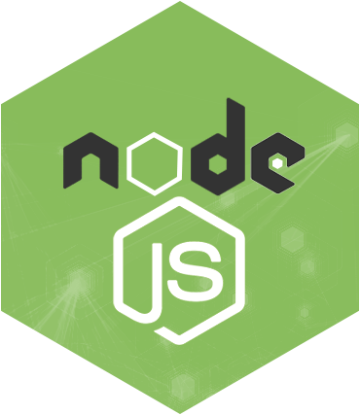
Node.js Web Server
How to build our own server

Slide 5
What Do the Web Servers Do? (Again)
All physical servers have hardware
The hardware is controlled by the operating system
Web servers are software products that use the operating system to handle web requests
Web servers serve Web content
These requests are redirected to other software products (ASP.NET, PHP, etc.), depending on the web server settings

Slide 6
Initialize Node.js Web Server
Require the 'http' module
Create server function (createServer)
Request/Response wrapper objects
Listen function (specifies port and IP (host))
Headers are objects (keys are lowercased)
const http = require('http');

Slide 7
Node.js Server Example
Define a port in range [0…65535]
const http = require('http');
const port = 1337;
http.createServer((req, res) => {
res.writeHead(200, {
'content-type': 'text/plain'
});
res.write('My server is running');
res.end();
}).listen(port);
Status code number and header object

Slide 8

URL
Parsing a URL in Node.js

Slide 9
URL module in Node.js
Require the 'url' module
The URL module splits up a web address into readable parts
Parse an address with the parse() function
const url = require('url');
let urlObj = url.parse(req.url);
Object with info about the url

Slide 10
URL parts
URL host 'localhost:8080'
URL path '/home'
URL search/query '?year=2017&month=february'
let host = urlObj.host;
let path = urlObj.pathname;
let search = urlObj.search;
let query = urlObj.query;
Returns an object

Slide 11
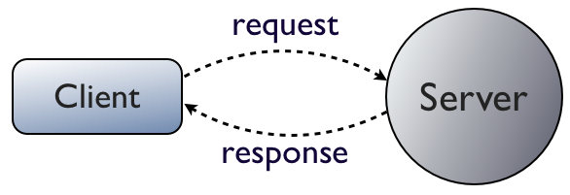
Request & Response Wrappers
How to handle a request/response

Slide 12

The Request Wrapper
The Request wrapper
Used to handle incoming http requests
Properties
httpVersion – '1.1' or '1.0'
headers – object for request headers
method – 'GET', 'POST', etc.
url – the URL of the request

Slide 13
Request Wrapper Example
const http = require('http');
const url = rquire('url');
const port = 1337;
http.createServer((req, res) => {
let path = url.parse(req['url']).pathname;
if (path === '/') {
// TODO: Retrieve index.html
}
}).listen(port);
Routing requests

Slide 14
The Response Wrapper
The Response wrapper
Used to retrieve a response to the client
Functions
Create response header
Send the actual content to the client
End the response

Slide 15
Response Wrapper Example
fs.readFile('./about.html', (err, data) => {
if (err) {
console.log(err);
return;
}
res.writeHead(200, {
'content-type': 'text/html'
});
res.write(data);
res.end();
})
Response status code
Content type should always be valid
Default encoding 'utf-8'
Always end the response

Slide 16



Additional Tools
Helper Modules

Slide 17
Yeoman
Easy application scaffolding
Then you need a generator
Then just create an app with
Contains a lot of predefined project generators
MEAN, AngularJS, Express, etc.
npm install –g yo
npm install –g generator-express
yo express

Slide 18

Gulp
Gulp is a Node.js task runner
It can runs different tasks, based on configuration
Concatenate and minify JavaScript/CSS files
Compile SASS/LESS/Stylus
Run jshint, csshint
Other famous runners are Grunt and WebPack
npm install –g gulp
npm install --save gulp

Slide 19
Gulp Demo
Popular Gulp tasks
Create 'gulpfile.js' at the root of the project
Write tasks and run 'gulp default'
Enter task name
gulp.task('scripts', function () {
del.sync(['build/**']);
return gulp.src(['content/jquery/dist/jquery.js'])
.pipe(uglify())
.pipe(gulp.dest('build'));
});
Source folder path

Slide 20
Bower
Legacy package manager for client-side libraries
Run
After that run
Then you can run
Or install it with
If you want to restore packages, run
Configuration is in '.bowerrc' file
More information at https://bower.io/docs/config/
npm install –g bower
bower init
bower search jquery
bower install jquery –save-dev
bower install

Slide 21
Summary
Node.js server is very lightweight and easy to use
Usage of third-party modules such as
Request/Response wrappers act like objects
JavaScript has a lot of tools to ease development (Grunt, Gulp, Yeoman, etc..)
const http = require('http');
const url = require('url');

Slide 22







Node.js Web Server
https://softuni.bg/courses/

Slide 23





Trainings @ Software University (SoftUni)
Software University – High-Quality Education, Profession and Job for Software Developers
softuni.bg
Software University Foundation
http://softuni.foundation/
Software University @ Facebook
facebook.com/SoftwareUniversity
Software University Forums
forum.softuni.bg

